Slide 1
Analog and Digital Comm

Slide 2
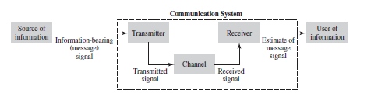

Slide 3
Four Basic Theories regarding Communication systems
1)Modulation Theory
2)Fourier Analysis
3)Detection Theory
4) Probability theory and random process

Slide 4
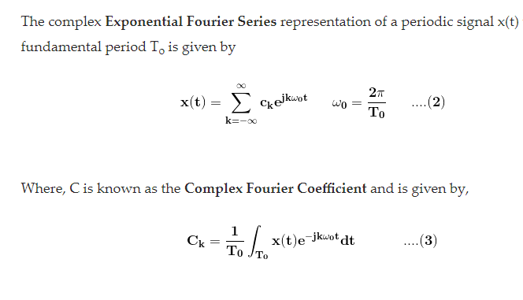
Fourier Series

Slide 5
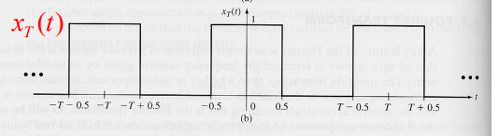
Problem 1.Draw spectrum of x(t)

Slide 6
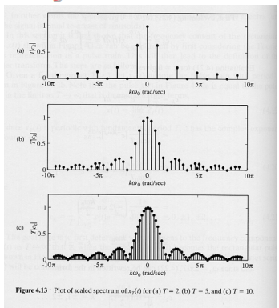
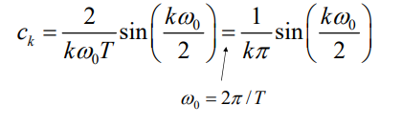

Slide 7
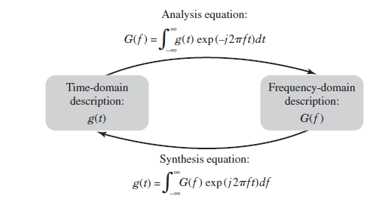
Fourier Transform

Slide 8
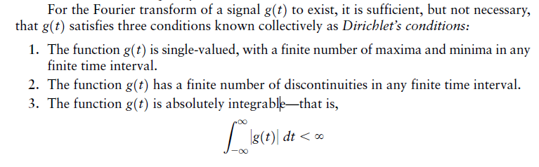

Slide 9
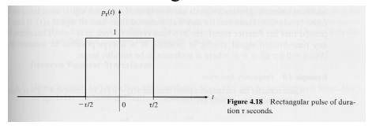
Problem 2 Find FT of the rectangulat pulse

Slide 10
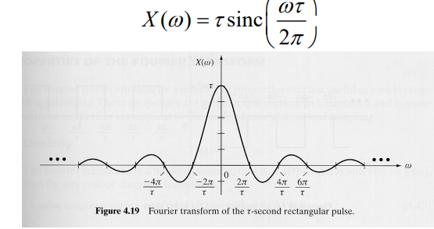

Slide 11
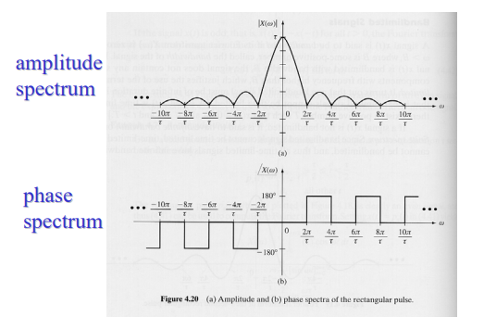

Slide 12

$$A rect(\frac{t}{T})=ATsinc(fT)$$

Slide 13
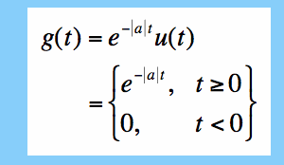
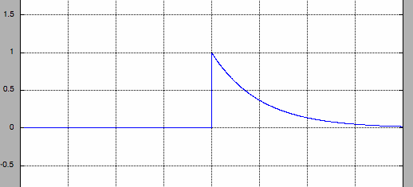
Prob 3:Find FT of

Slide 14
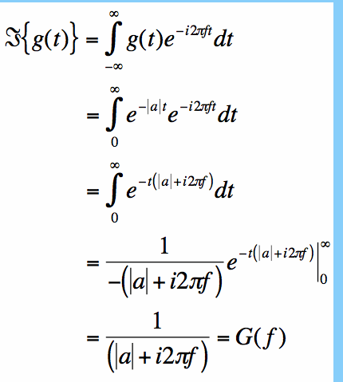

Slide 15
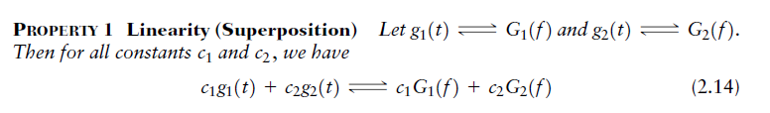
Properties of FT

Slide 16
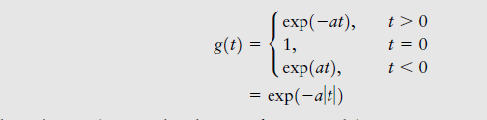
Prob: Find FT of

Slide 17
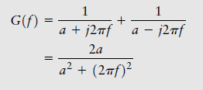

solution

Slide 18
